Slide 1
Understanding Machine Learning From Theory to Algorithms
Powered by: Moftak solutions

Slide 2
Mubashar Nazar Awan
Former ML Intern @ ReVeaL Lab
Former Graduate Research Assistant @AIM Lab
Data Scientist @Moftak Solutions

Slide 3
Agenda
Artificial Intelligence vs Machine Learning vs Data Science.
What is Machine Learning?
Available tools for ML.
Algorithms used for ML.
Learn and Earn.
Future of ML.

Slide 4
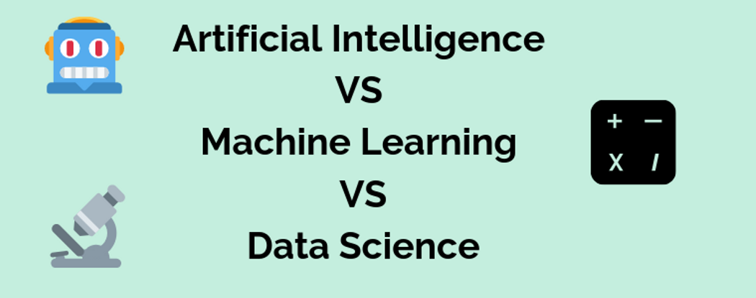

Slide 5
What is Machine Learning?
Machine Learning is the subfield of Computer Science that gives computers the ability to learn without being explicitly programmed.
Machine Learning algorithms, inspired by human learning process, iteratively learn from data, and allow computers to find hidden insights.

Slide 6
Application of machine learning
Recommendation systems –Netflix, YouTube, Amazon etc.
Loan Approval
Fraud detection
Telecommunication Companies – Churn Prediction
And many others.

Slide 7
Popular ML Techniques
Regression
Classification
Clustering
Association
Recommendation Systems

Slide 8
Supervised vs. Unsupervised
Supervised Learning
Unsupervised Learning
Deals with labelled data.
Classification
Regression
Deals with unlabelled data.
Clustering
Association

Slide 9
Available tools for ML
Languages: python- Numpy, Pandas, Matplotlib, Scikit-Learn
Others: R, SQL, Julia-high performance numerical analysis, handles huge datasets
Tools: Jupyter Notebook , pycharm, R studio
Online tools: google colab, kaggle kernel, AWS

Slide 10
How different ML Algorithms work?

Slide 11
K Nearest Neighbours

Slide 12
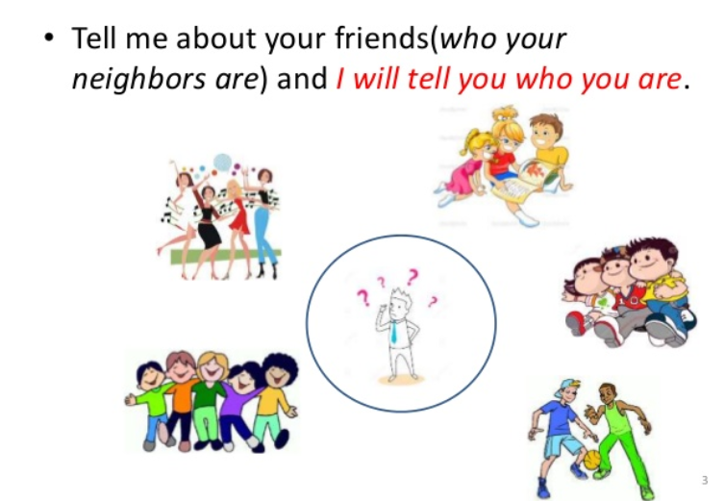

Slide 13
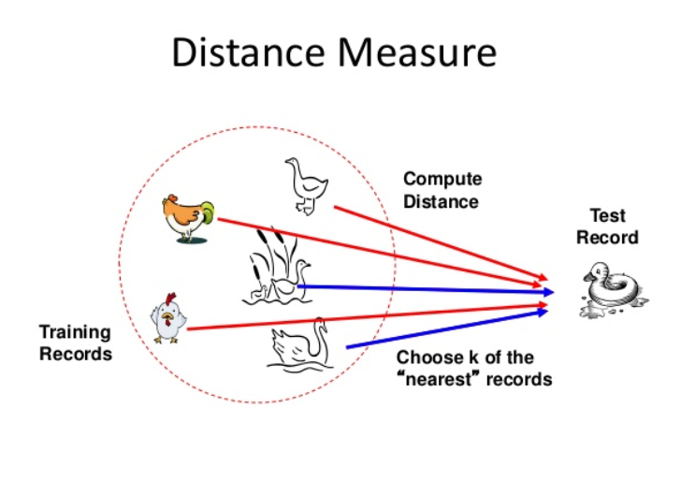

Slide 14
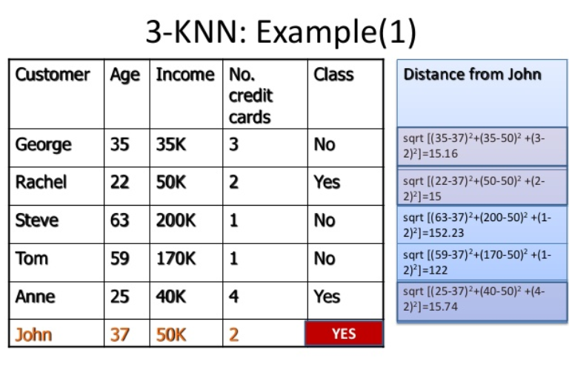

Slide 15
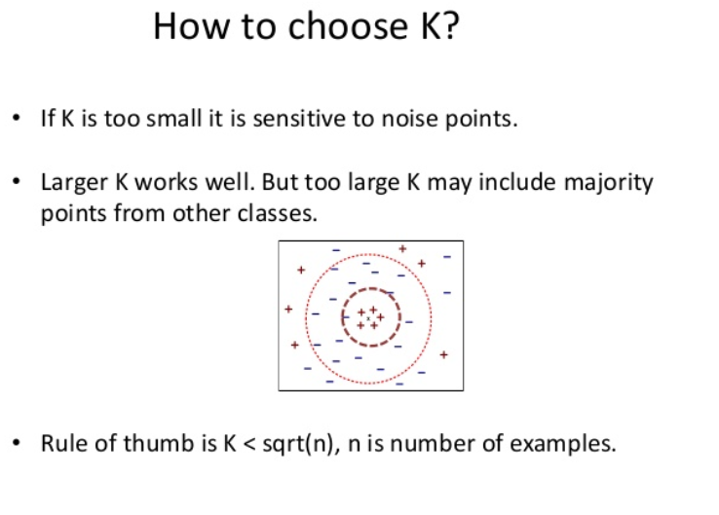

Slide 16
Review Question
k-NN algorithm does more computation on test time rather than train time.
A) TRUE B) FALSE

Slide 17
Review Question
k-NN algorithm does more computation on test time rather than train time.
A) TRUE-Correct B) FALSE

Slide 18
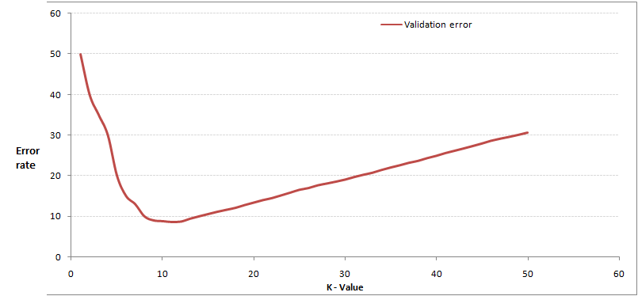
In the image below, which would be the best value for k assuming that the algorithm you are using is k-Nearest Neighbor.
A) 3 B) 10 C) 20 D 50

Slide 19
In the image below, which would be the best value for k assuming that the algorithm you are using is k-Nearest Neighbor.
A) 3 B) 10-Correct C) 20 D 50

Slide 20
Coding demo

Slide 21
Linear Regression

Slide 22
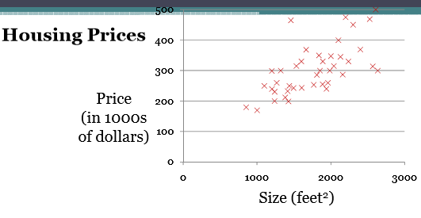

Slide 23
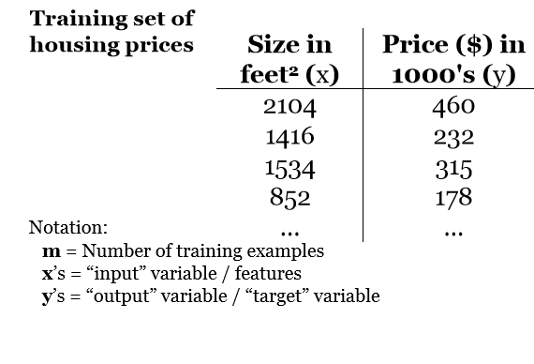

Slide 24
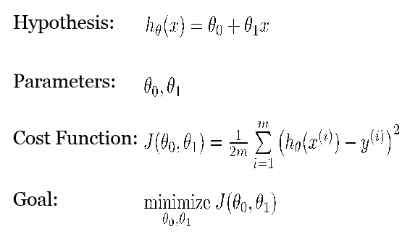

Slide 25
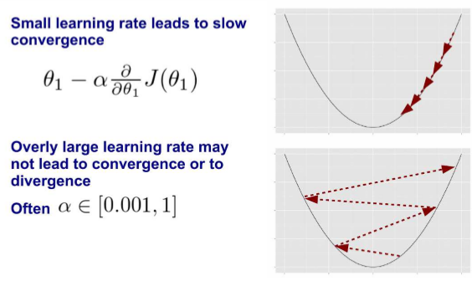

Slide 26
Review Question
Linear Regression is a supervised machine learning algorithm.
A) TRUE B) FALSE

Slide 27
Review Question
Linear Regression is a supervised machine learning algorithm.
A) TRUE-Correct B) FALSE

Slide 28
Coding demos

Slide 29
K-means Clustering

Slide 30
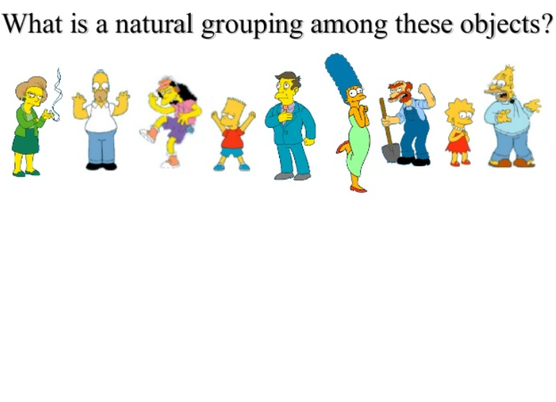

Slide 31
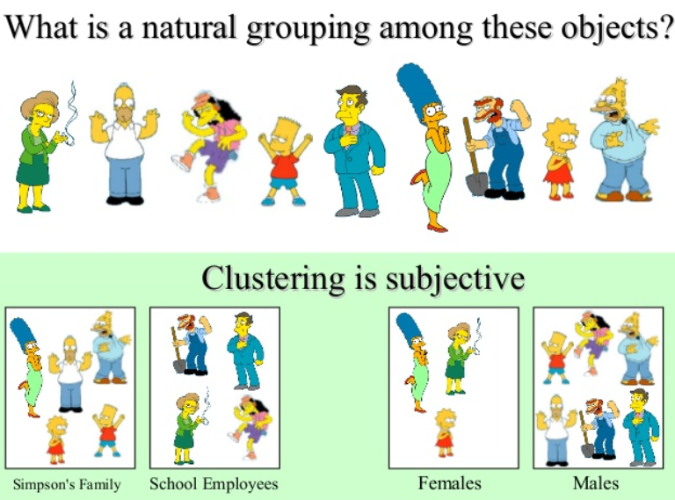

Slide 32
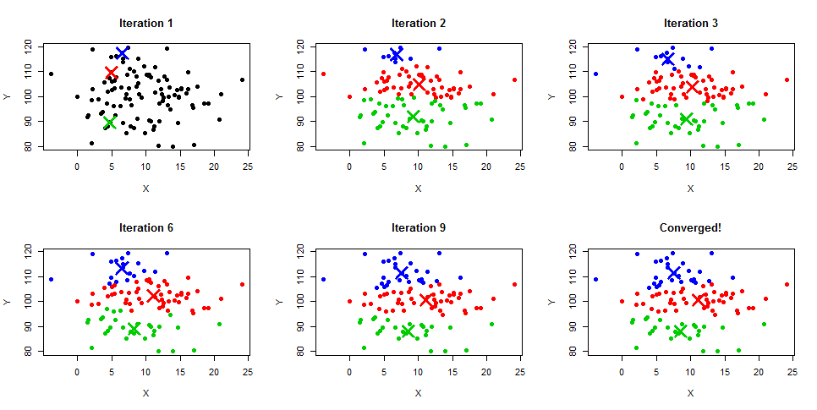

Slide 33
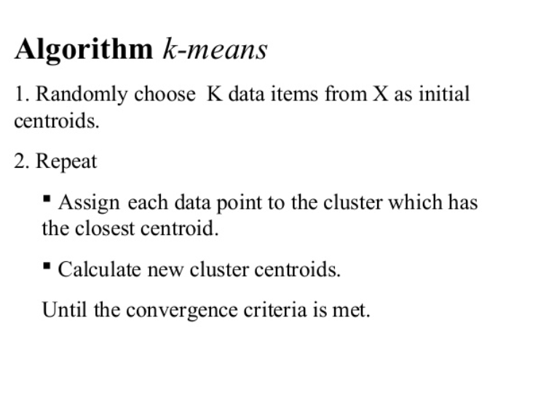

Slide 34
Review Question
For two runs of K-Mean clustering is it expected to get same clustering results?
A) Yes B) No

Slide 35
Review Question
For two runs of K-Mean clustering is it expected to get same clustering results?
A) Yes B) No-Correct

Slide 36
Coding demo

Slide 37
Association Rule Mining

Slide 38
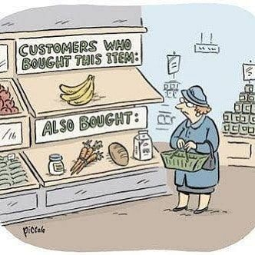

Slide 39
Apriori principle
If an item set is frequent, then all of its subsets must also be frequent.

Slide 40
Recommendation systems

Slide 41
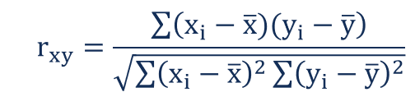
Correlation

Slide 42
Learn and Earn
Courera
Udemy
DataCamp
Kaggle
Freelansing

Slide 43
Future of ML
lots of training data required, researchers working on to reduce it.
No code environment.
Generic AI.
Detect Depression.
AI in Judiciary.

Slide 44
Thank You

